Slide 1
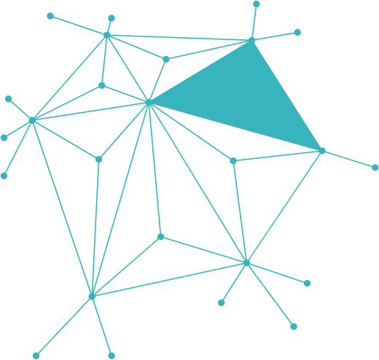

CYBER SECURITY
Global Threat Analysis (2016-2024)

Slide 2

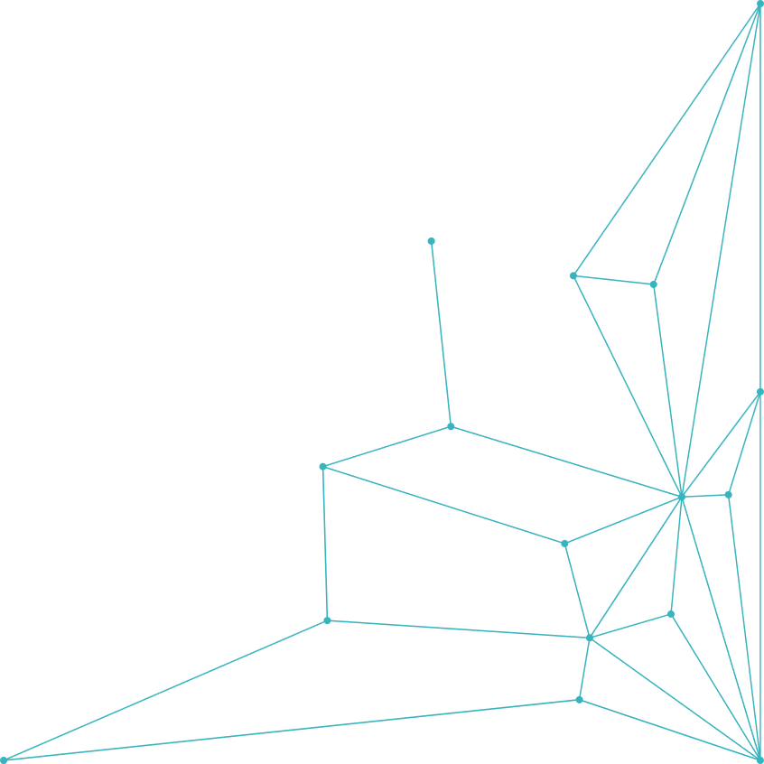
PROJECT
INTRODUCTION
Objectives -Transform reactive security → proactive defense (pattern recognition)
Business Value -Security = strategic investment, not cost
Problem -Hard to make strategic decision -Lack of understanding: threats, attack vectors, defense
Evolution of Attack
90%

Slide 3
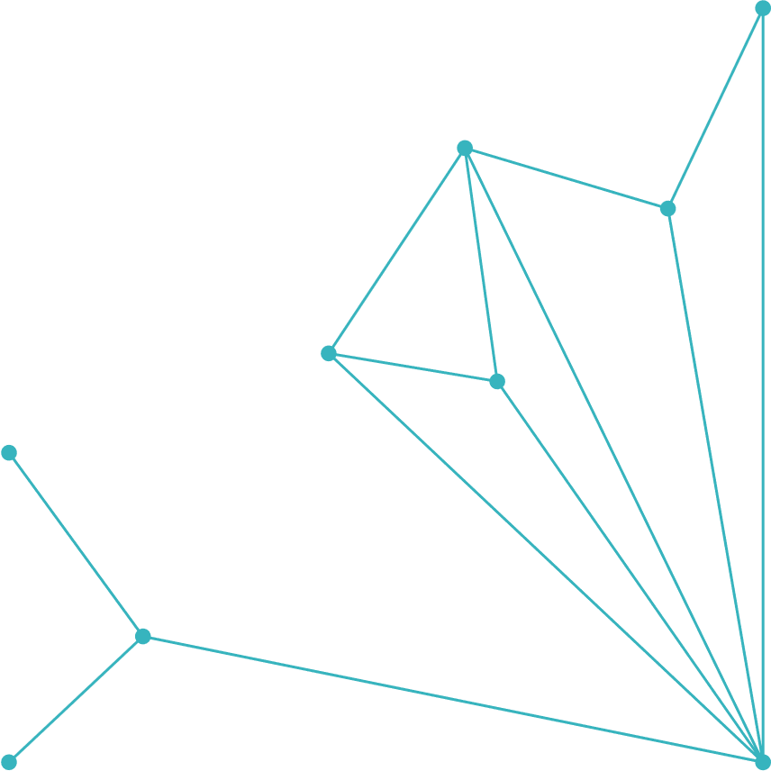
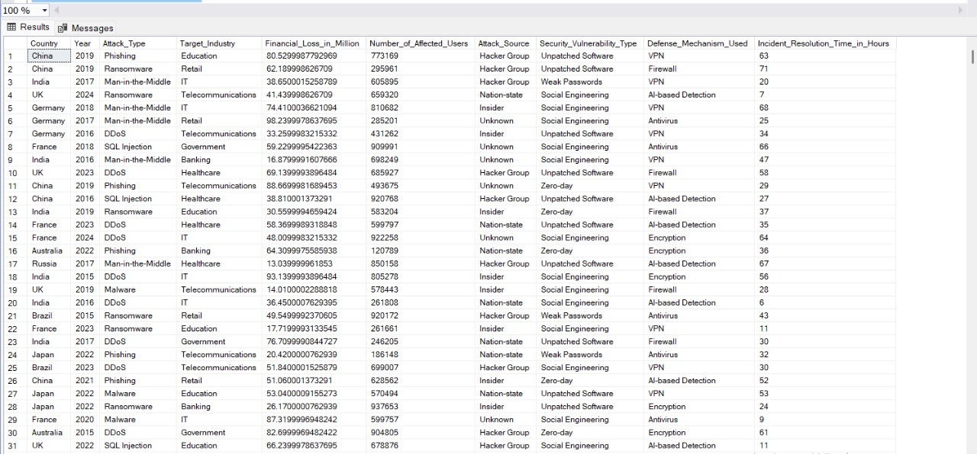
DATA OVERVIEW
Total Records: 3000+ sophisticated cyber incidents
Time Frame: 2016 – 2024
Geographic Spread: 10 major nations (China, India, UK, USA, Brazil, Japan, Australia, Russia, Germany, France)
Industries Covered: 7 critical sectors
Data Points: 10+ metrics per incident

Slide 4

DATA OVERVIEW
&
Objective
Scope
What We Measured
Visual
Study 15 major cases
Identify key threats & effective defenses
Countries: China, India, UK, Germany, France
Sectors: Critical industries (7 total)
Financial loss
Users impacted
Attack sources
Response efficiency
Country flags + industry icons

Slide 5


OUR ANALYTICAL MISSION:
Primary Objective:
Shift from reactive → proactive security
Predict threats using pattern recognition
Core Questions:
What vulnerabilities are most exploited?
Which actors cause the most damage?
How effective are current defenses?
What new attack trends are emerging?
Business Value:
Security as strategic investment, not cost

Slide 6
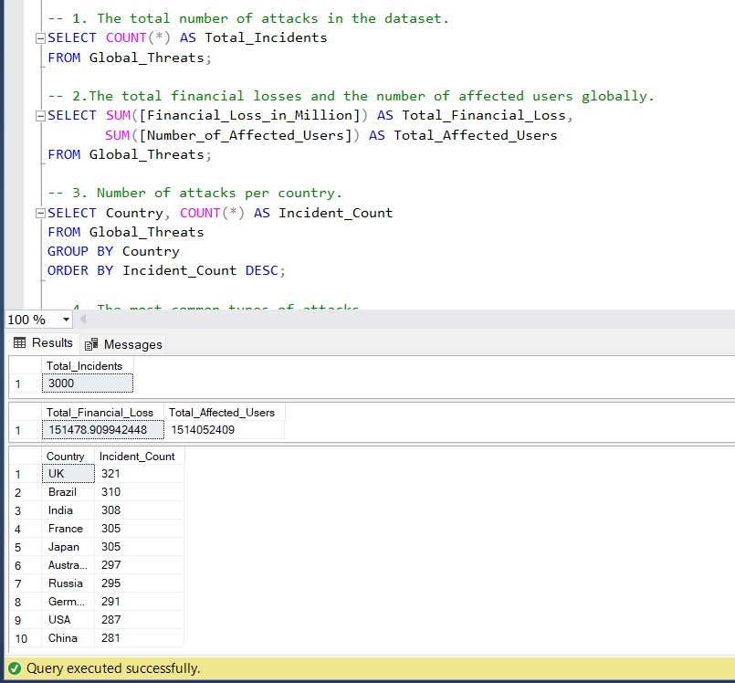
OUR ANALYTICAL PROCESS

Slide 7
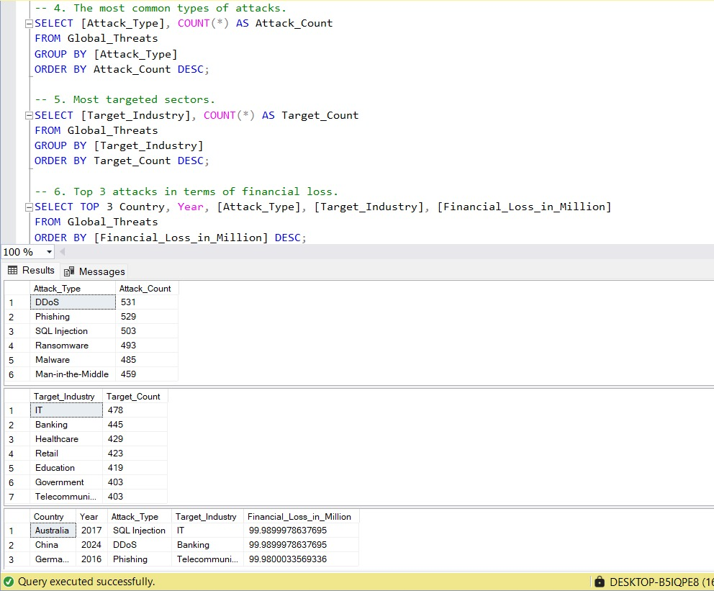
OUR ANALYTICAL PROCESS

Slide 8
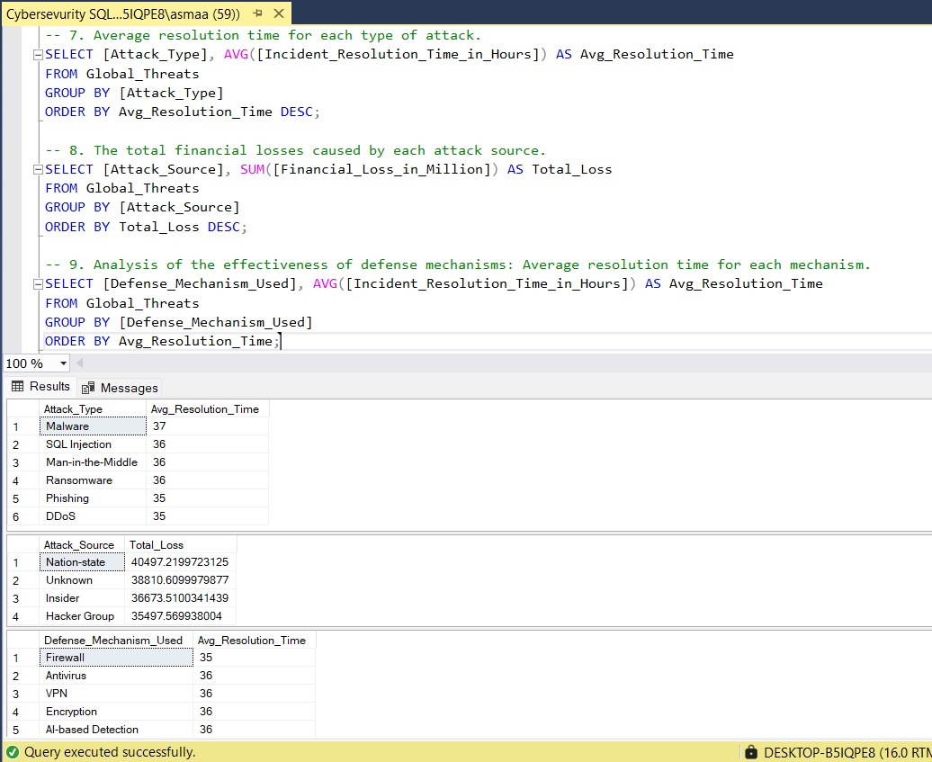
OUR ANALYTICAL PROCESS

Slide 9
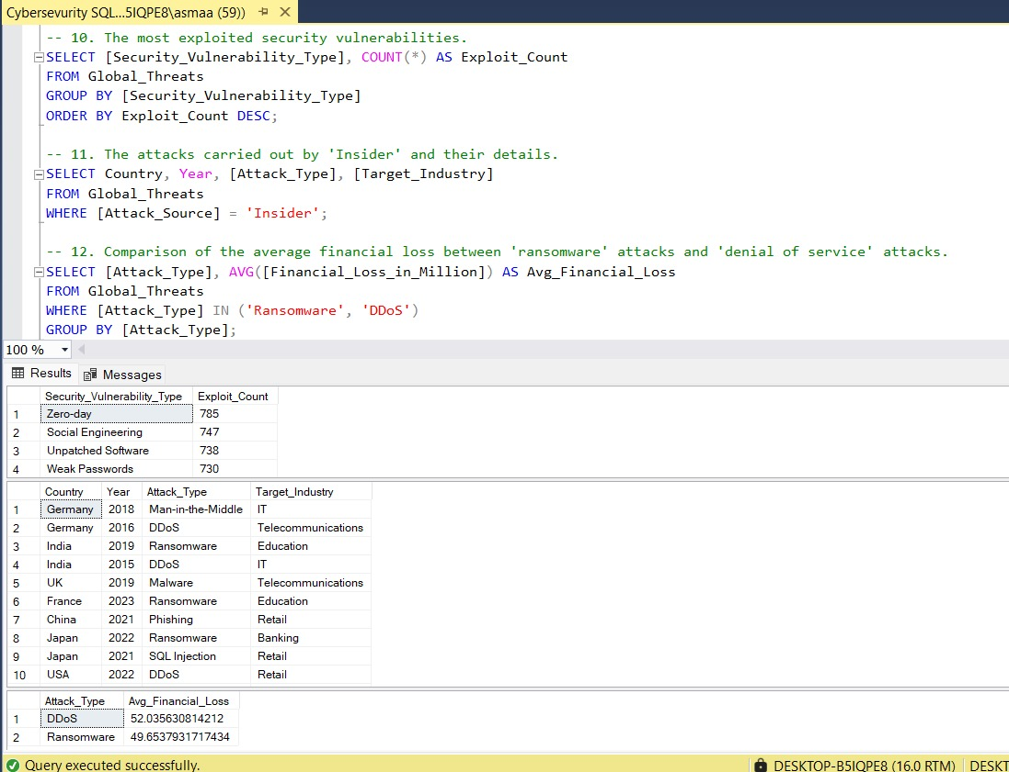
OUR ANALYTICAL PROCESS

Slide 10
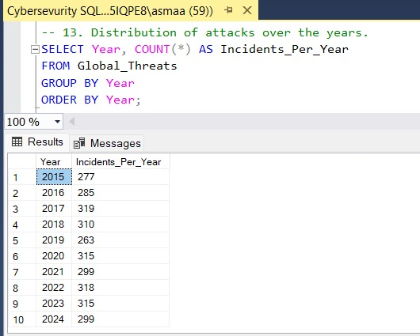
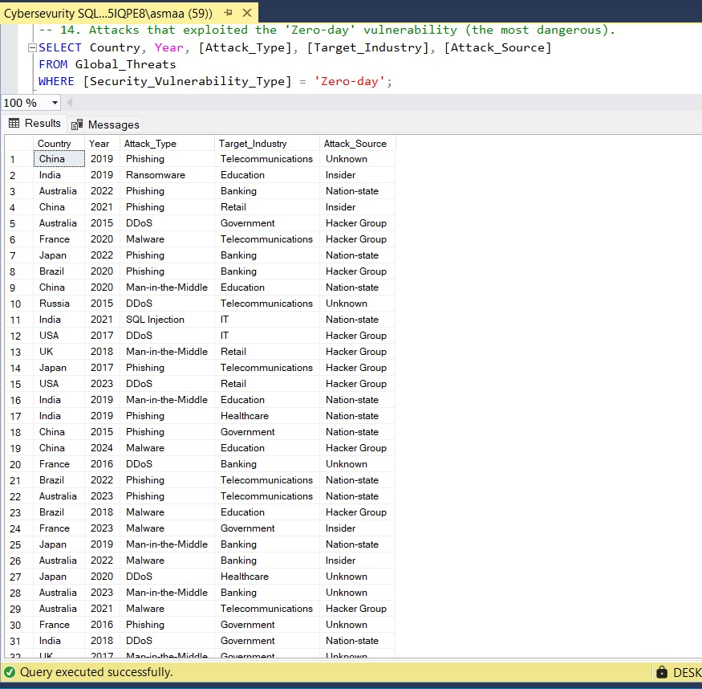
OUR ANALYTICAL PROCESS

Slide 11
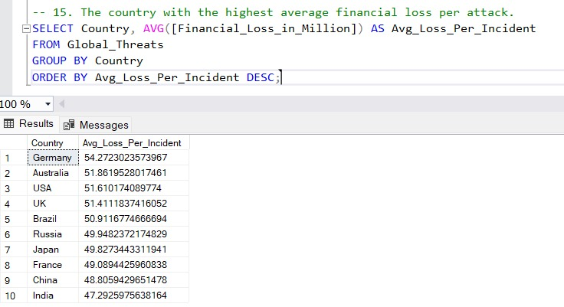
OUR ANALYTICAL PROCESS

Slide 12



INSIGHTS
Number of attacks per country
UK 321 - Brazil 310 - India 308 - France 305 - Japan 305 - Australia 297 - Russia 295 - Germany 291 - USA 287 - China 281
The most exploited security vulnerabilities.
Zero-day 785 - Social Engineering 747
Unpatched Software 738 -Weak Passwords 730
Most targeted sectors
IT 478 - Banking 445 - Healthcare 429 - Retail 423 - Education 419 - Government 403 - Telecommunications 403
Average resolution time for each type of attack
Distribution of attacks over the years
Malware 37 - SQL Injection 36 -
Man-in-the-Middle 36 - Ransomware 36 - Phishing 35 - DDoS 35
2015 > 277 - 2016 > 285 - 2017 > 319 - 2018 > 310 - 2019 > 263 - 2020 > 315 - 2021 > 299 -
2022 > 318 - 2023 > 315 - 2024 > 299

Slide 13




CONCLUSIONS &
STRATEGIC RECOMMENDATIONS
IMMEDIATE ACTIONS (0-6 MONTHS):
MEDIUM-TERM INITIATIVES (6-12 MONTHS):
LONG-TERM STRATEGY (12+ MONTHS):
training, patching, insider threat checks
AI detection, zero-trust roadmap, better incident response
predictive models, risk quantification, continuous improvement

Slide 14

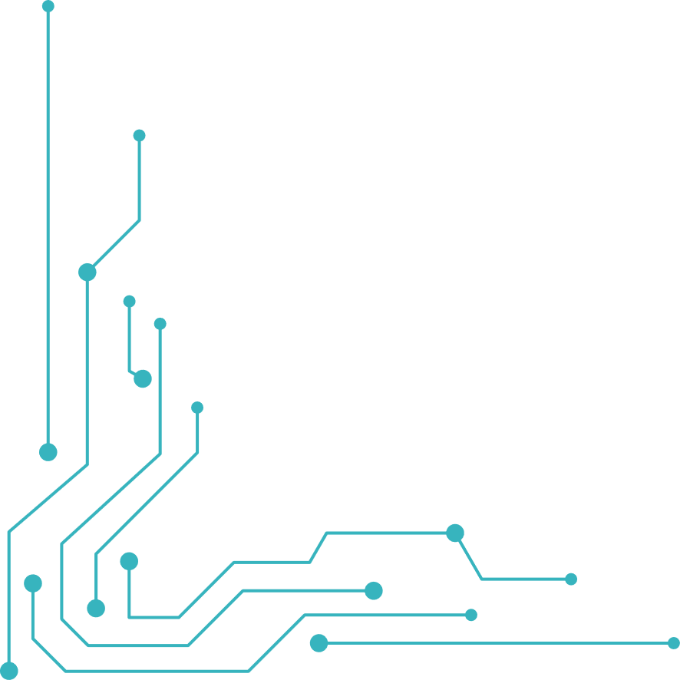
DISCUSSION &
FUTURE VISION
Human factor remains the biggest vulnerability
AI will significantly improve detection & response
Data-driven security = stronger strategies

Slide 15
DISCUSSION &
FUTURE GOALS
Predictive models for forecasting threats
Real-time dashboards for monitoring
Industry-specific benchmarks
Self-learning defense systems

Slide 16
THANKS
Prepared by: Asmaa Mostafa
Supervisor: Eng/ Dina Mohsen

